Slide 1
March Meeting
Zoom Meeting & 700 Governors Drive
3-27-2024 10:00 AM

Slide 2
Agenda
10:00 AM Call Meeting to Order- Chairman
Roll Call of Members- Secretary
Additional Items to be added to agenda
Approve meeting minutes of December meeting
Organizations
Police Chiefs Assn. – Jason Jones
Sheriff’s Assn – Steve Swenson
DCI/Attorney General – Chad Mosteller
GFP – Bruce Nachtigall
DOT – Brian Wacholz
National Guard – David Goodwin
Emergency Managers – Pat Harrington
Firefighters – Charlie Kludt
Healthcare – Tim Rave
Highway Patrol – Garrett Wellman
APCO/NENA – Kevin Karley
EMT – Brent Long
Wildland Fire – Ray Black
County Commissioners – Kade Haley
Health Department – Chuck Kevghas
Tribal Governments – Jim Pearson
Federal Government – Andy Barth
BIT Engineering – Trent Nincehelser
SD Senate – John Wiik
SD House of Representatives – David Kull
911 – Jason Husby

Slide 3
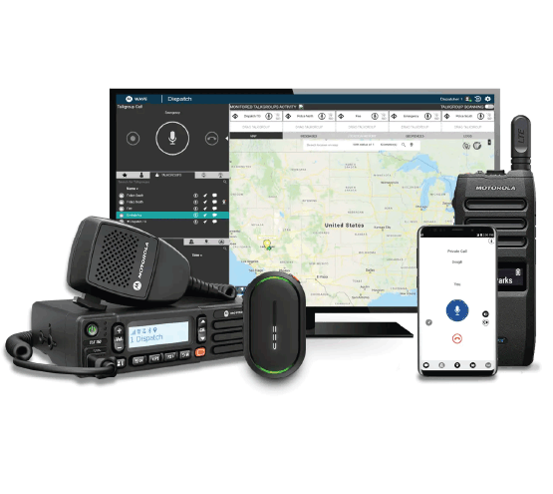
New Business
1. SWIC Updates – Todd Dravland (SWIC South Dakota)
2. System Upgrade Status – Completed
System Cleanup/Unused radios post project
Smart Connect/Critical Connect – start identifying standards for Wi-Fi and LTE interoperability with RF
RoIP Policy – first draft

Slide 4
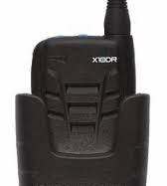
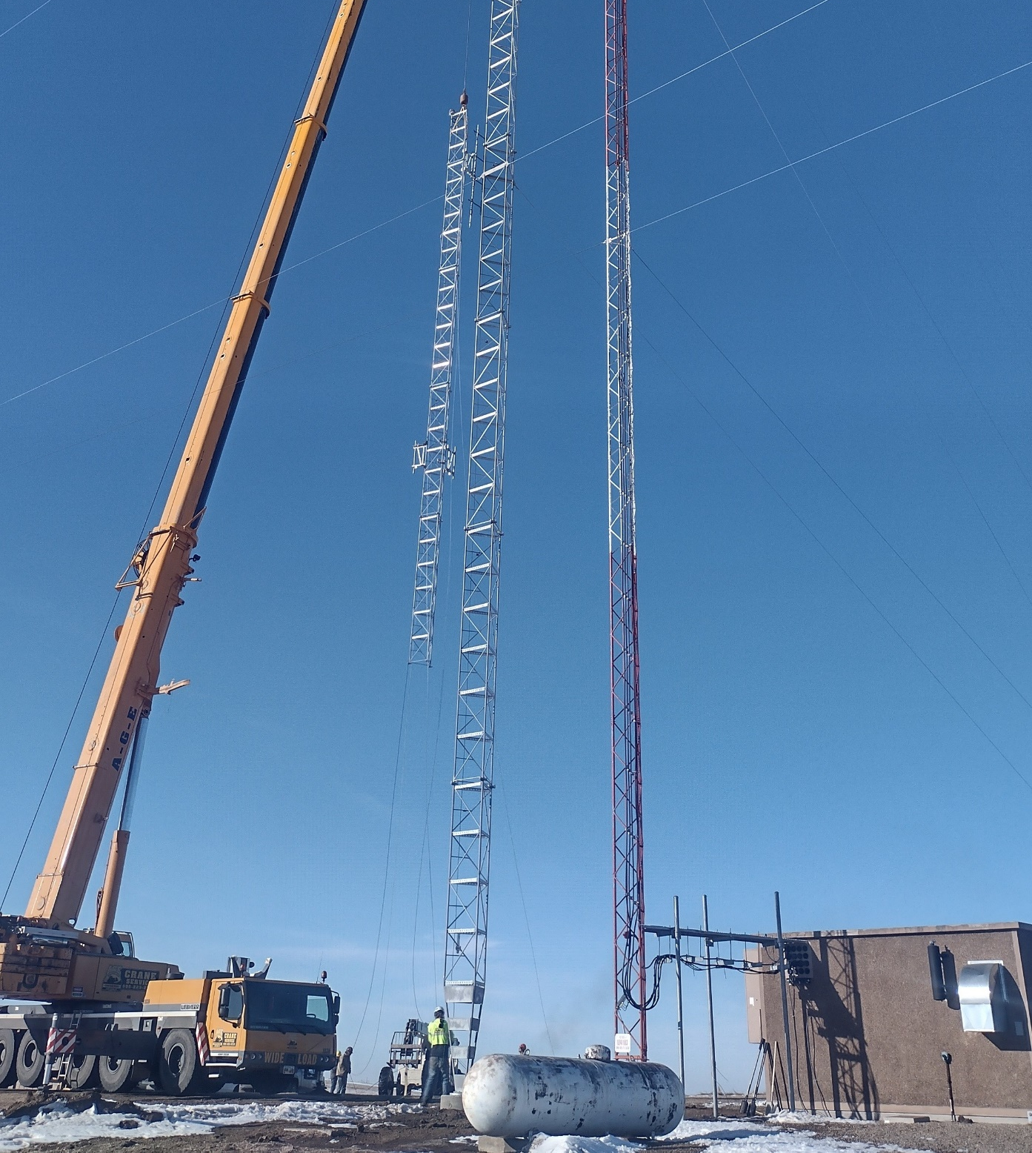
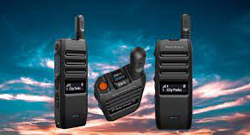
New Business (continued)
3. Radio Programming challenges
Review - 100 User minimum requirement for volunteers
Continue to seek programming volunteers within your organizations
Monthly town hall style meetings for volunteers with State Radio staff
RF programmer forum
4. Isabel Tower site replacement update – Complete
5. New SRC tech solutions presentation – Recent technical innovation to bridge gaps in RF communications
TLK 110
X10DR (testing)
Smart Connect
Responder Network SSID

Slide 5
New Business (continued)
6. Formula for Identifying Underserved Areas – motion to approve as standard for SDPSCC
Champion redundant core solution ask for funds
7. I90 Corridor update
$46,000 funding appropriated to state radio for radio coverage study
Will need to define scope of the study and identify consultant
Determine next steps pending study results
8. Minnehaha County projects update
North Minnehaha simulcast
Plan to move VA subsite in Summer 2024 during tower water tower maintenance

Slide 6
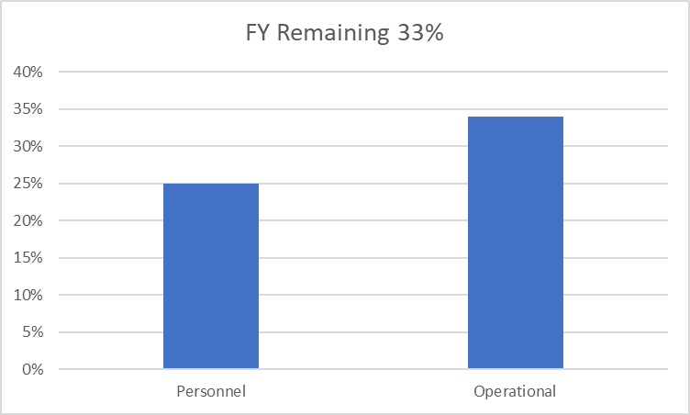
Old Business
Budget
Nearly 22% of total operational budget is paid in July for annual Motorola support contract
34% Personnel and 25% of Operational funds available
There may be budget challenges this year with the conclusion of P25 project

Slide 7
Old Business (Continued)
2. Broadband Subcommittee Report – Kendall Light
FirstNet Buildout Updates– Doug Penniston
3. T-Mobile Presentation
4. Organization Representative Vacancies
NO Vacancies pending formal appointment process currently
John Wiik 6/30/2024
Officer election in upcoming June meeting

Slide 8
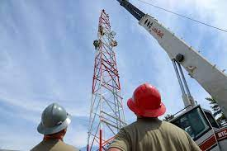
Old Business (Continued)
5 Year plan
Year 2024 | Identify, champion, and promote sustainable funding for State radio system. Broadband subcommittee does formal evaluation of public safety apps and make recommendation. Examine capabilities of Critical Connect/Smart Connect for cross-border solution. Identify and request funding to build expansion sites as authorized for improved mobile coverage. Form subcommittee to look at PSAP direct -connect options work with 911 coordinator. Investigate potential for remote radio management in South Dakota. Champion/Recommend redundant core solution for BIT Commissioner to address in 2025 legislation. Form subcommittee to create policy for RoIP solutions. Promote volunteer radio programmers in South Dakota.
Year 2025 | Full-scale review of industry technology and trends relating to Public Safety Draft any changes/recommendations for BIT Commissioner to address in 2026 legislative session. Review SDPSCC website and modernize. 2 council members attend APCO or IWCE national conference. Review of wireless carrier capabilities & recommend improvements. Review & recommend PSAP/dispatch improvements related to LMR system & applications.
Year 2026 | Propose recommendation from industry review in conjunction with 2025 review. Recommend expansion sites as needed. 2 council members attend APCO or IWCE national conference. Full review of council by-laws, membership, and structure Standardized recommendation for CAD services across the State of South Dakota Full review of COMU program
Year 2027 | TBD
Year 2028 | TBD
4. 5 Year Plan Review
Identify and list objectives for years 2027 and 2028
Seeking input from SDPSCC

Slide 9
Organizational Reports
Organization Reports
Police Chiefs Assn. – Jason Jones
Sheriff’s Assn – Steve Swenson
DCI/Attorney General – Chad Mosteller
GFP – Bruce Nachtigall
DOT – Brian Wacholz
National Guard – David Goodwin
Emergency Managers – Pat Harrington
Firefighters – Charlie Kludt
Healthcare – Tim Rave
Highway Patrol – Garrett Wellman
APCO/NENA – Kevin Karley
EMT – Brent Long
Wildland Fire – Ray Black
County Commissioners – Kade Haley
Health Department – Chuck Kevghas
Tribal Governments – Jim Pearson
Federal Government – Andy Barth
BIT Engineering – Trent Nincehelser
SD Senate – John Wiik
SD House of Representatives – David Kull
911 – Jason Husby
Closing Comments
Vice-chair – Garrett Wellman
Member at Large - Kevin Karley
Chair – Bruce Nachtigall
Next Meeting: date, time, location

